Slide 1
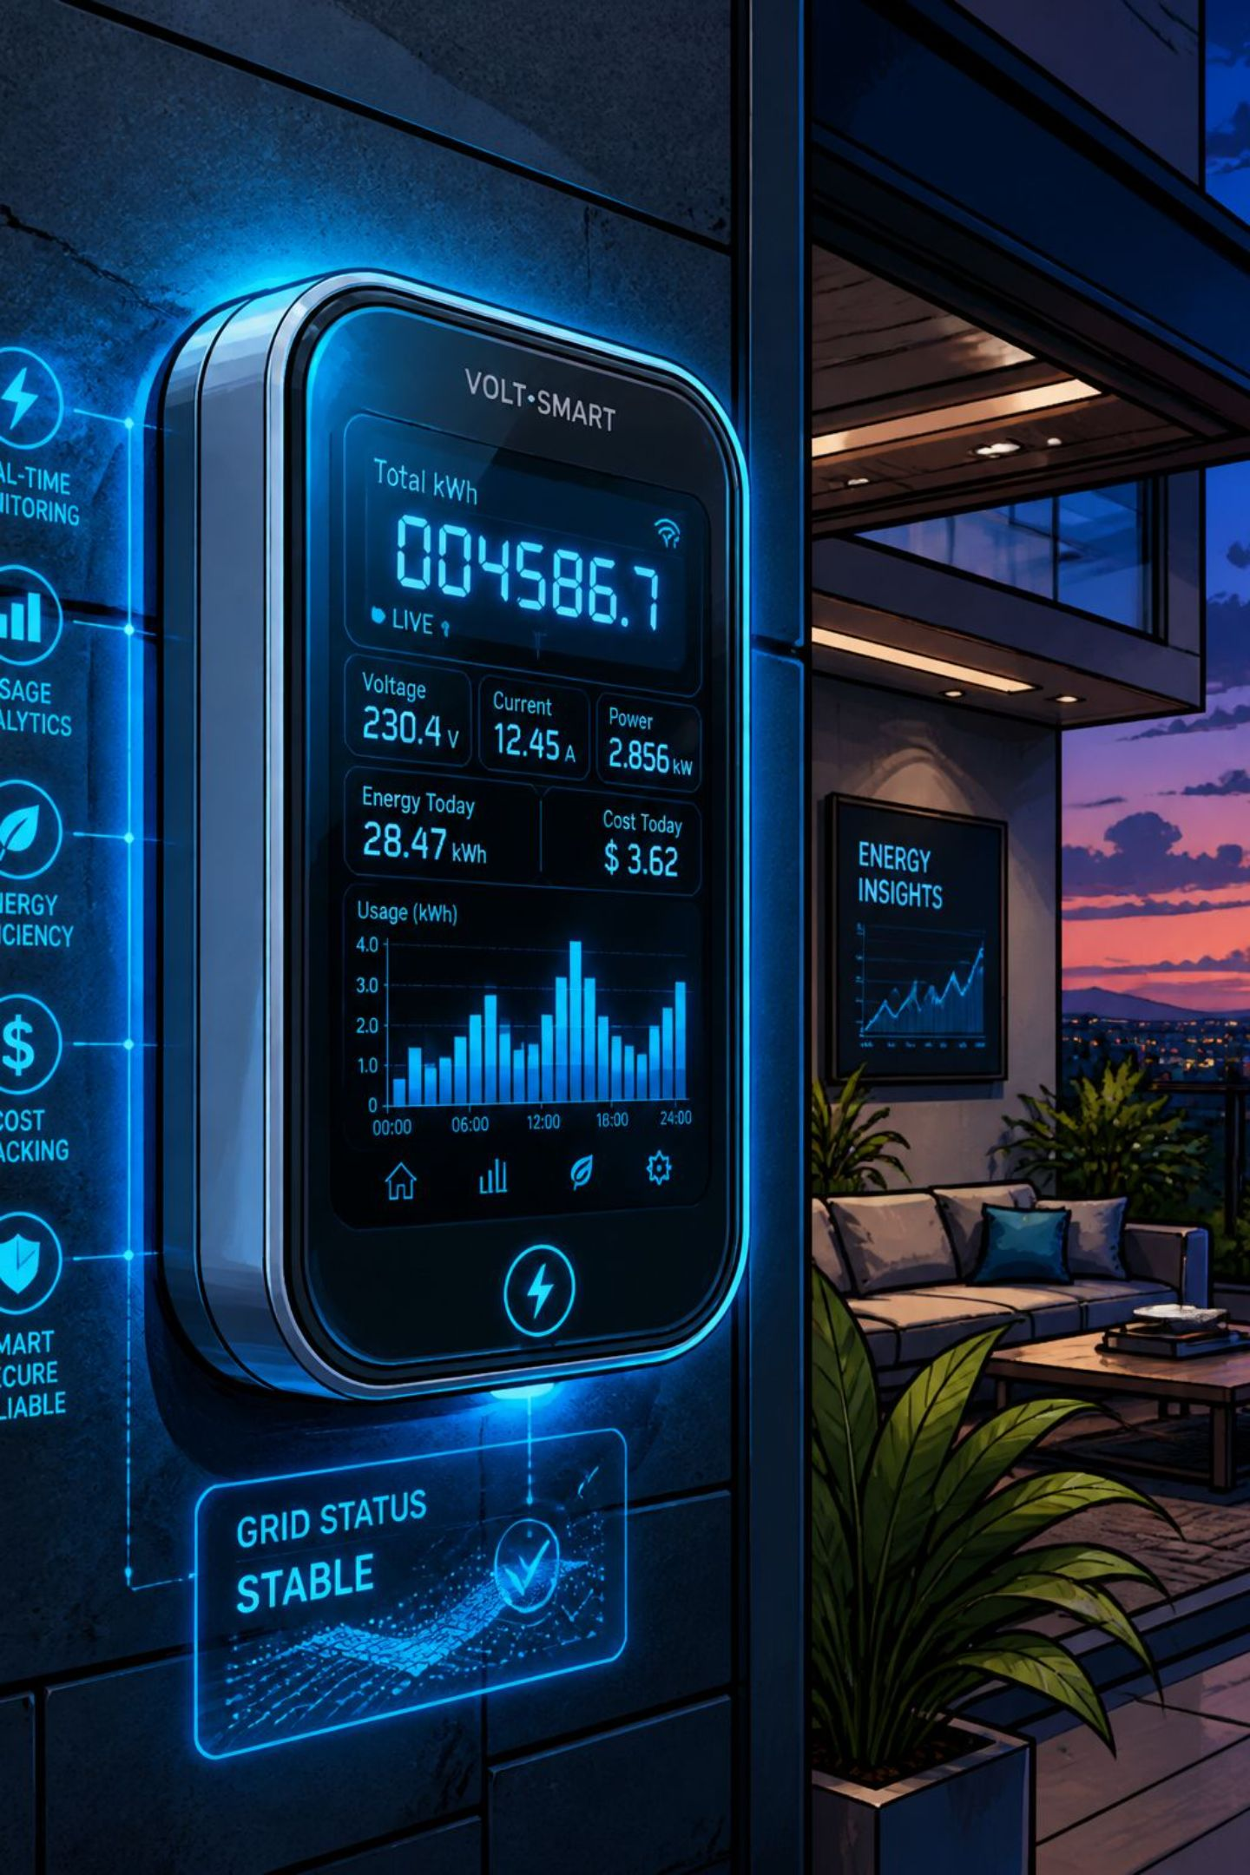
Monthly Electricity Bill Prediction System
Using historical energy consumption and usage patterns to forecast future electricity costs — empowering smarter financial planning and sustainable energy decisions.
MACHINE LEARNING
PREDICTIVE ANALYTICS
ENERGY INTELLIGENCE

Slide 2

The Problem With Traditional Billing
Rising Costs
Reactive Billing
Global electricity prices have climbed steadily, with household consumption growing due to increased appliance usage and climate-driven demand.
Consumers receive bills only after electricity has been used — making it nearly impossible to estimate costs, budget accurately, or adjust consumption in time.
No Predictive Insight
Traditional systems lack forward-looking analytics, leaving households without tools to plan expenses or adopt energy-saving practices proactively.

Slide 3
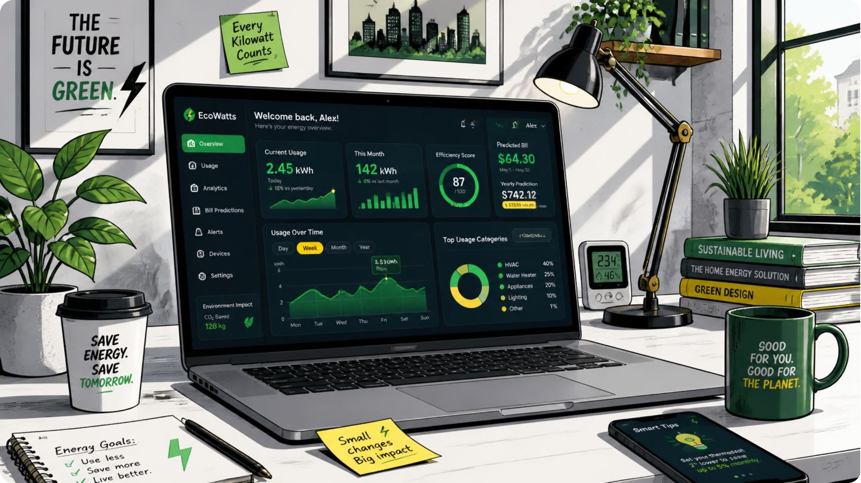

The Proposed Solution
The system leverages machine learning and historical consumption data to predict monthly electricity bills before they are issued — transforming reactive billing into proactive energy management.
Collects
Analyzes
Predicts
Usage records, appliance patterns, seasonal data, occupancy info, and tariff rates.
Historical trends and consumption anomalies using regression models.
Accurate future bills with actionable energy-saving recommendations.

Slide 4
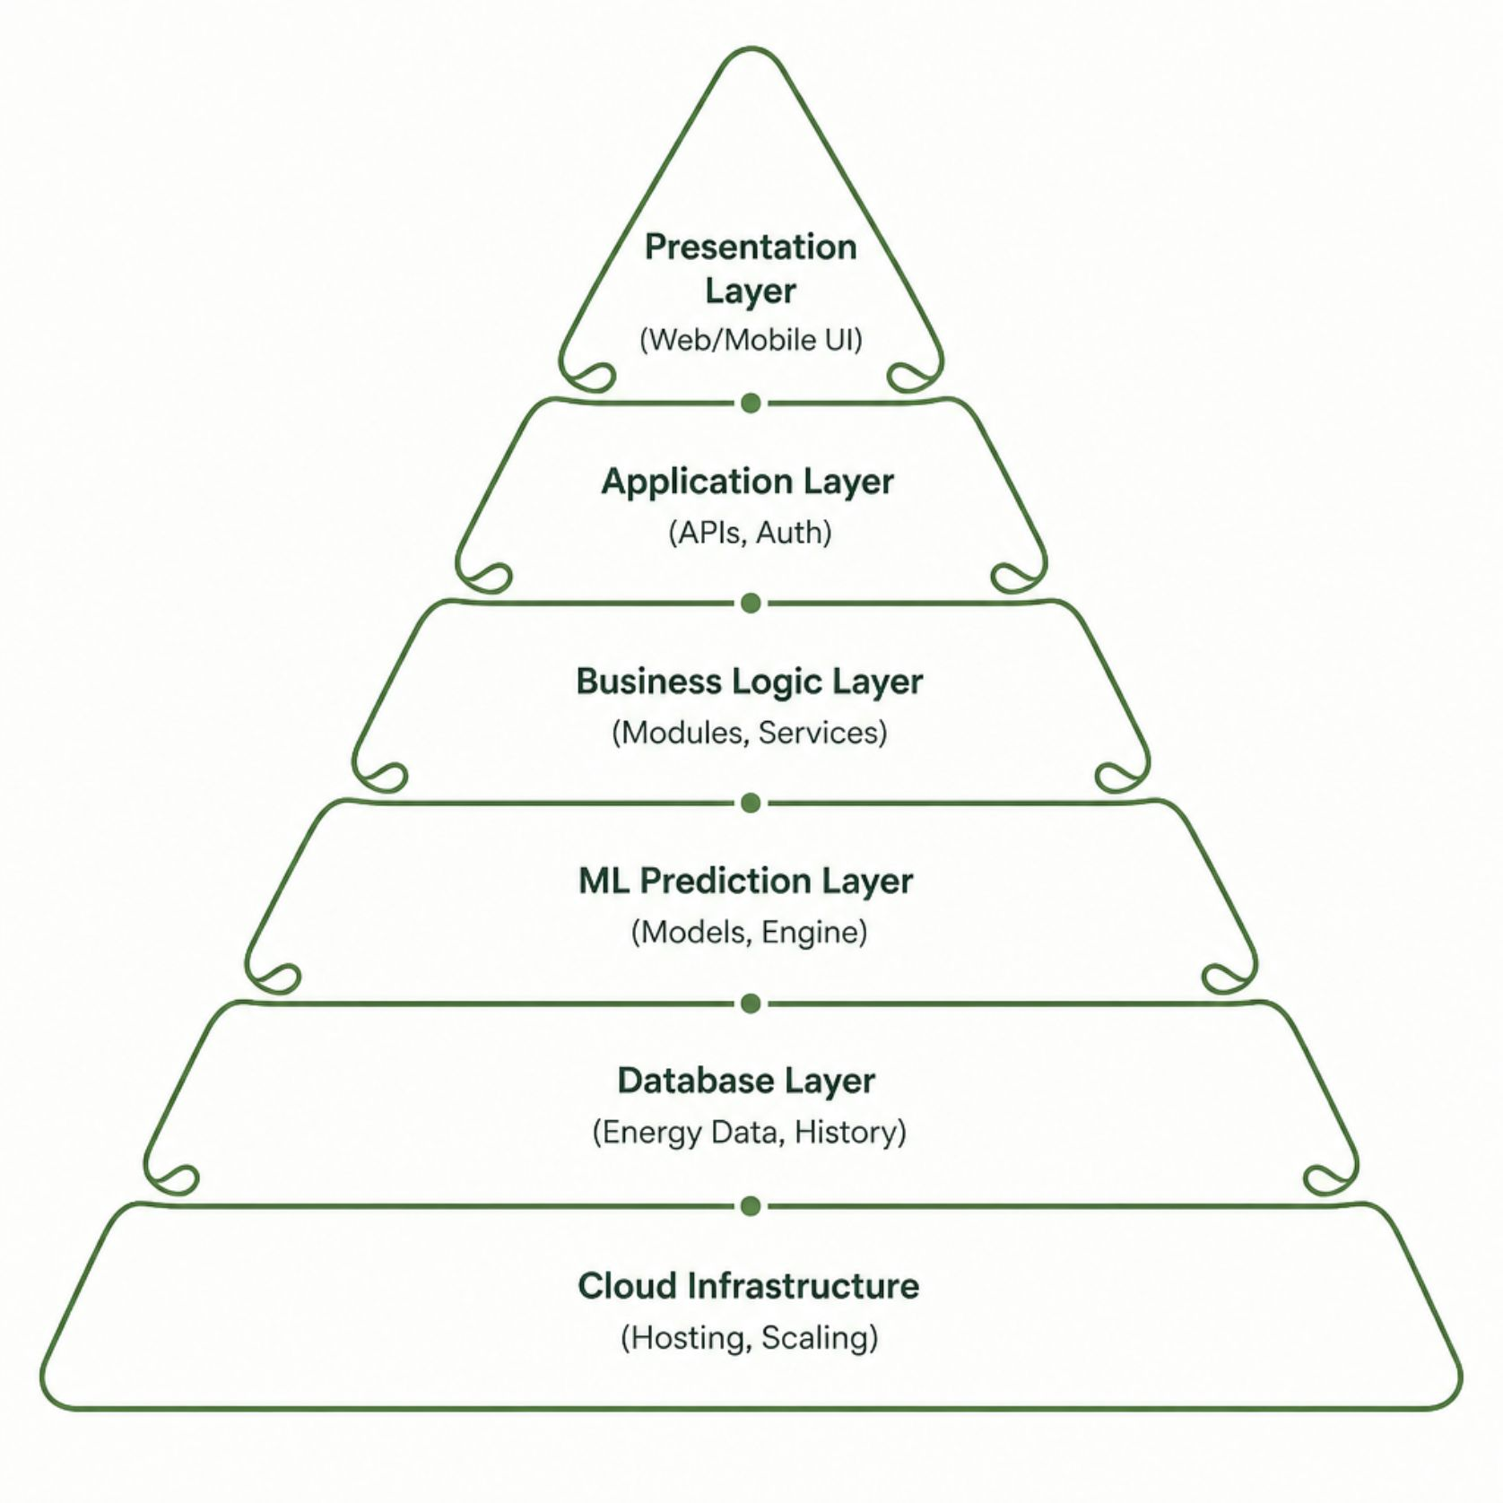

System Architecture
A six-layer architecture ensures modularity, scalability, and intelligent prediction delivery — from user interaction to cloud-hosted ML inference.
Presentation Layer
Application Layer
ML Prediction Layer
Database Layer
Web and mobile interfaces for users and administrators.
REST APIs, authentication, and business logic orchestration.
Regression models, feature engineering, and tariff calculation.
Time-series energy data, user profiles, and prediction history.
Cloud Infrastructure
Scalable hosting, containerization, and automated deployment.

Slide 5
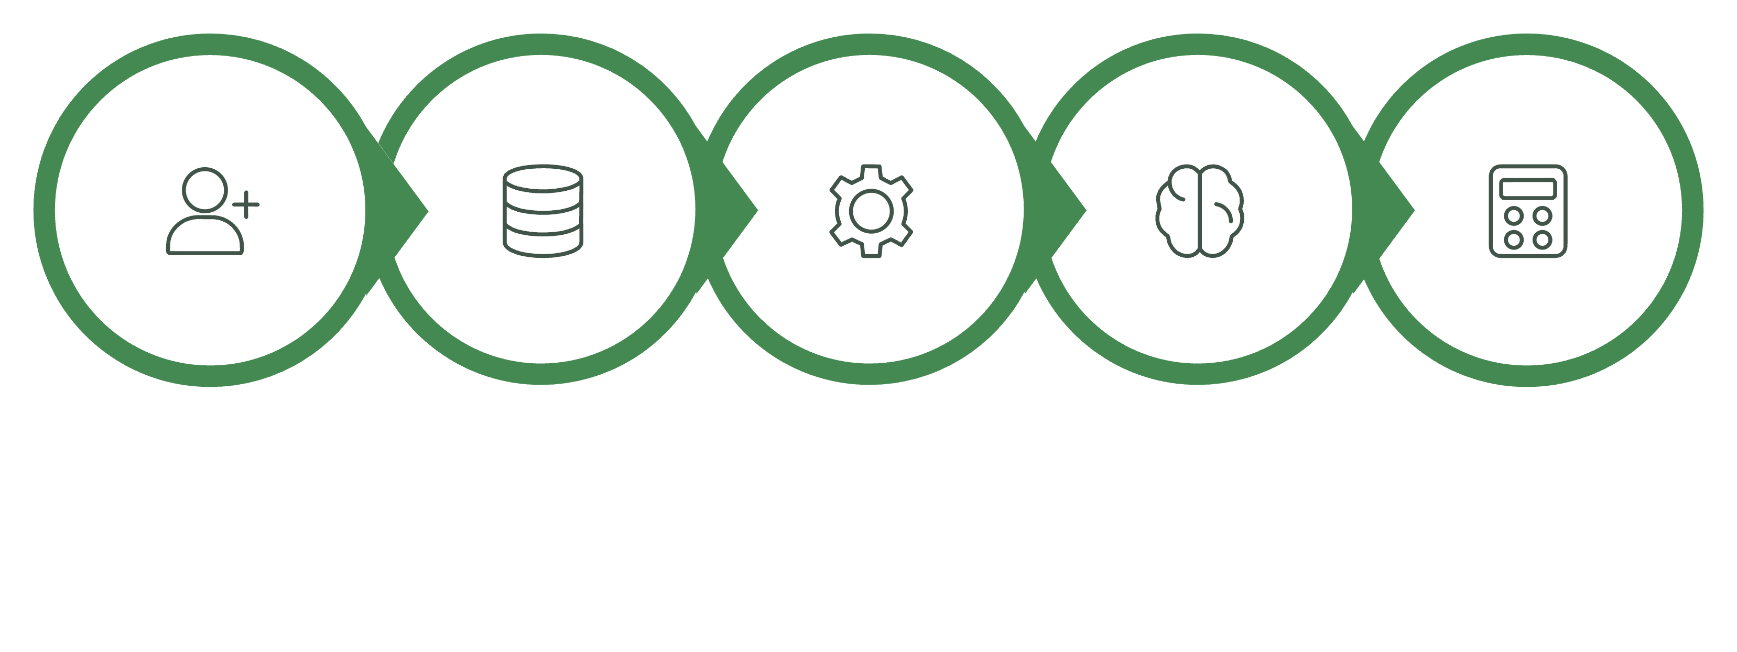
Complete System Workflow
Feature Extract
User Signup
Preprocess
Model Train
Bill & Tariff
The pipeline operates as a continuous feedback loop — each new billing cycle enriches the training dataset, improving prediction accuracy and recommendation relevance over time.

Slide 6

Machine Learning Pipeline
Regression Algorithms
Evaluation Metrics
Linear Regression
Decision Tree
MAE
RMSE
Mean Absolute Error
Root Mean Squared Error
Random Forest
Gradient Boosting
SVR
XGBoost
R² Score
Response Time
Model fit quality
Inference latency
Models are retrained on a scheduled basis with fresh consumption data, ensuring predictions adapt to seasonal shifts and evolving user behavior.

Slide 7
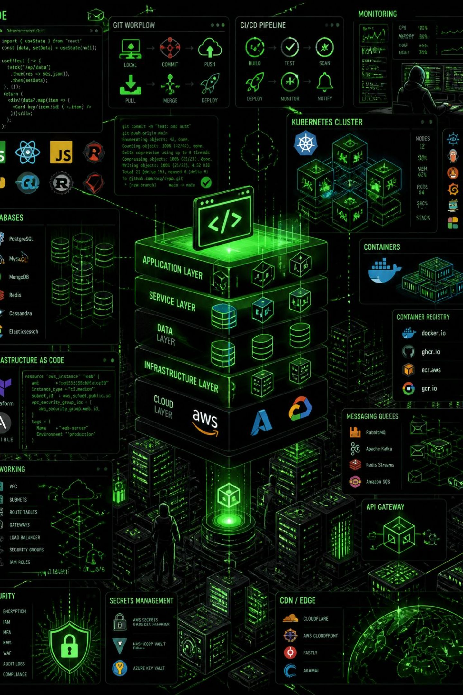




Technology Stack
Frontend
React.js / Angular, D3.js & Chart.js for interactive energy dashboards and consumption visualizations.
Backend & APIs
Python (Flask/FastAPI), Node.js, RESTful APIs with JWT authentication and role-based access control.
Data & ML
PostgreSQL, Redis, Scikit-learn, XGBoost, TensorFlow — time-series storage and regression modeling.
Cloud & DevOps
AWS / Azure, Docker, Kubernetes, CI/CD pipelines for scalable, high-availability deployment.

Slide 8
Key Advantages & Real-World Applications
Why It Matters
Where It Applies
Accurate Forecasting
🏠 Households & Smart Homes
🏢 Commercial Buildings
Bill predictions with measurable MAE/RMSE benchmarks.
Financial Planning
⚡ Utility Companies
🏭 Industrial Facilities
Households budget with confidence before the billing cycle ends.
Personalized Savings
🎓 Educational Institutions
🌆 Smart City Initiatives
Appliance-level recommendations reduce consumption and costs.
Sustainability
Encourages reduced usage and supports carbon footprint awareness.

Slide 9





Challenges & How We Address Them
Data Quality & Gaps
Variable Tariff Structures
Missing or inconsistent meter data is handled through imputation algorithms, outlier detection, and smart meter validation protocols.
Dynamic tariff modules support time-of-use rates, slab-based pricing, and regional regulatory differences across utility providers.
Seasonal Fluctuations
Privacy & Security
Seasonal feature encoding and cyclical pattern recognition ensure models account for heating, cooling, and holiday consumption spikes.
End-to-end encryption, GDPR-compliant data handling, and anonymized aggregation protect user consumption data at every layer.

Slide 10
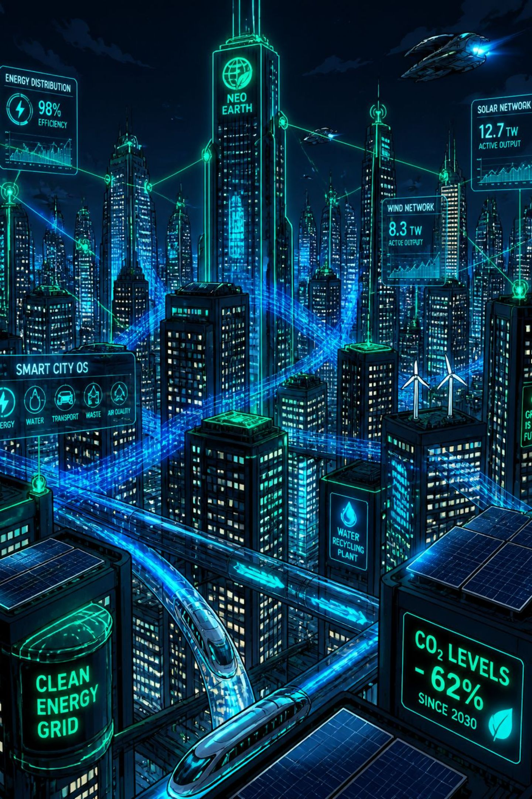

The Road Ahead
The system's roadmap extends predictive intelligence into real-time, IoT-connected, and sustainability-focused energy ecosystems.
1
Phase 1
Deep learning forecasting (LSTM/Transformer models) and real-time smart meter integration.
2
Phase 2
IoT-enabled appliance-level monitoring, renewable energy optimization, and carbon footprint estimation.
3
Phase 3
Mobile applications, voice-enabled assistants, dynamic tariff forecasting, and smart home automation integration.
4
Phase 4
Cloud-native, multi-tenant platform for utility providers and smart city energy management ecosystems.
This system transforms electricity billing from a reactive surprise into a proactive, intelligent tool — empowering consumers, utilities, and cities to manage energy with confidence.

